Slide 1
Welcome to Girl Scout Cookie Program Training
November 17, 2012

Slide 2
Your Sale
Who, What, Where, Why and How

Slide 3
Anything when she’s part of the worlds largest girl-led business!

Slide 4
Who can sell Girl Scout Cookies?
All registered Girl Scouts can sell cookies if they have parental permission.

Slide 5
The Girl Scout Cookie Sale 5 Key Skills
• Goal Setting • Decision Making • Money Management • People Skills • Business Ethics

Slide 6
How do we sell cookies?
Order Taking
Direct Sales
Booth Sales
Online Marketing

Slide 7
When does the sale start?
December 21, 2012

Slide 8
Important Dates
Girls Take Orders
Direct Orders Due
Order Taking Orders
Deliveries Begin
Sale Ends
December 21st
January 2 – in Snap
January 13 – in Snap
January 18
March 27, 2013

Slide 9
Money Matters
$4.00 box
Proceeds
Based on PGA
Girls Registered
1-99 pkgs $0.46
100-159 pkgs $0.49
160-199 pkgs $0.59
200+ pkgs $0.69
$750M

Slide 10
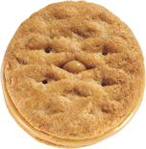
America’s Best Cookies!
Thanks-A-Lot™
Shortbread cookies dipped in rich fudge and topped with an embossed thank you message in one of 5 languages.
Mango Crèmes with NutriFusion™ Vanilla and coconut cookies filled with a tangy mango flavored crème enhanced with nutrients derived from fruits.
Shortbread
Traditional shortbread cookies.
Lemonades™ Savory slices of shortbread with a refreshingly tangy lemon flavored icing.
Thin Mints
Crispy chocolate wafers dipped in a mint chocolaty coating.
Peanut Butter Patties® Crispy vanilla cookies layered with peanut butter and covered with a chocolaty coating.
Caramel deLites® Vanilla cookies coated in caramel, sprinkled with toasted coconut, and laced with chocolaty stripes.
Peanut Butter Sandwich
Crisp and crunchy oatmeal cookies with creamy peanut butter filling.

Slide 11
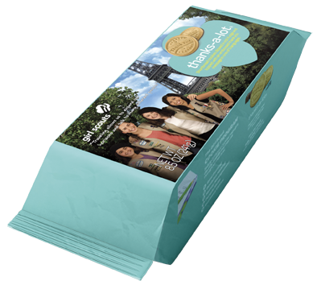
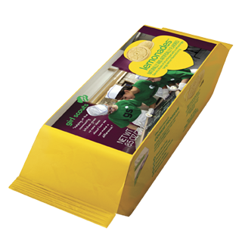
Reduce Waste
By eliminating the carton on Thanks-A-Lot and Lemonades, Girl Scouts of the USA and ABC Bakers are taking more than 300 tons of paperboard out of the waste stream annually.

Slide 12
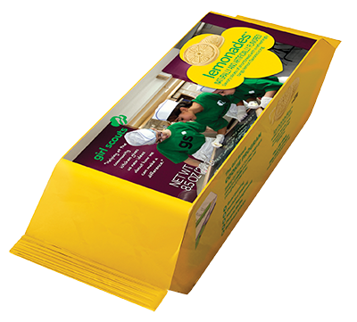
New packaging
Plus the new package designs for Thanks-A-Lot and Lemonades makes them easy to stack at booth sales!

Slide 13
Sustainability
• Official member of the Roundtable on Sustainable Palm Oil (RSPO)
• Palm oil sourced exclusively from members of the RSPO to encourage sustainable farming practices
• Starting in 2012, we will incorporate mass balance sustainable palm oil in our Girl Scout cookies
• We also are purchasing Green Palm certificates to cover 100% of our projected palm oil requirements for the 2012-13 season Girl Scout Cookie season

Slide 14
9 out of 10 consumers will buy if asked!
* GSUSA, IRI Grocery Store Data - 52 weeks ending 1st Qtr 2012

Slide 15
Cookie Materials
Engage and inform girls and their families
Make sale as easy as possible to support
Provide multiple formats for busy volunteers!

Slide 16
Resources
For Girls

Slide 17
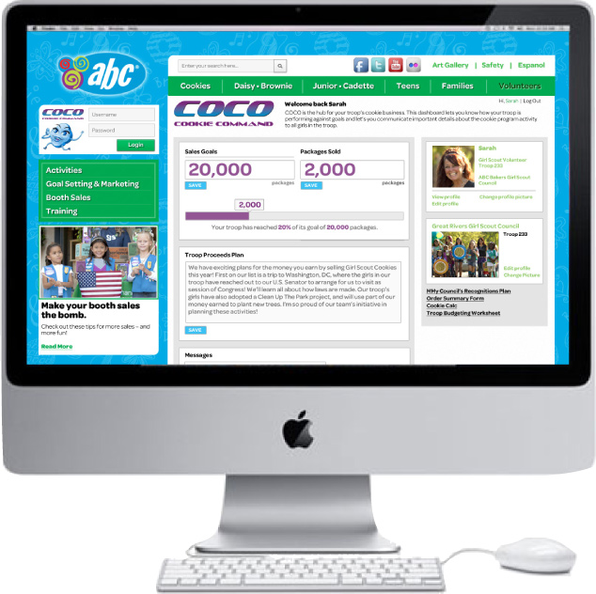
INTRODUCING COCO!
Online “Cookie Command” center for girls
Goal Setting
Sale Planning
Consumer Marketing
Community/Sharing

Slide 18
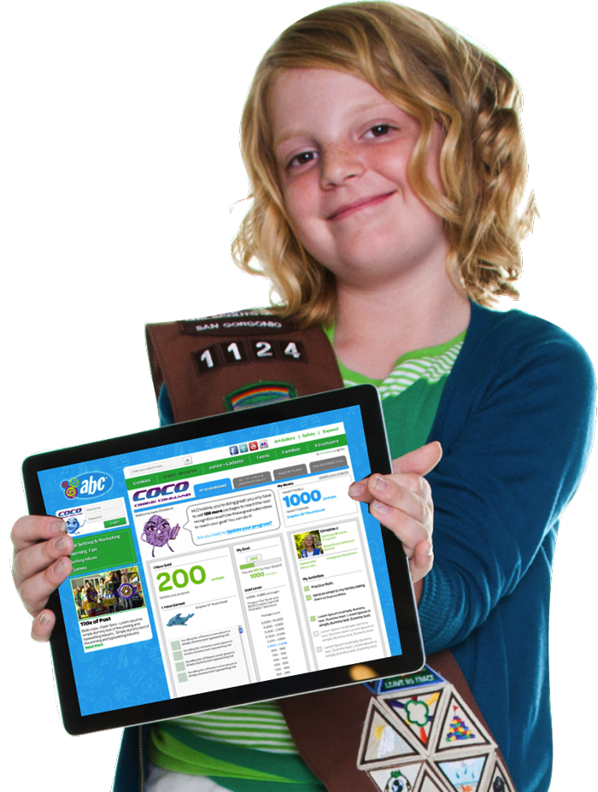
Goal Setting
View recognitions and set package goal
Track progress
Set reach goals
Monitor performance within troop
Cheer on troop teammates

Slide 19
Sale Planning
Develop an activity plan
Track progress against plan
Earn and display 5 Key Skills activity bling

Slide 20
Consumer Marketing
Send e-cards to friends and families
Collect orders online
Maintain contact database for use next year

Slide 21
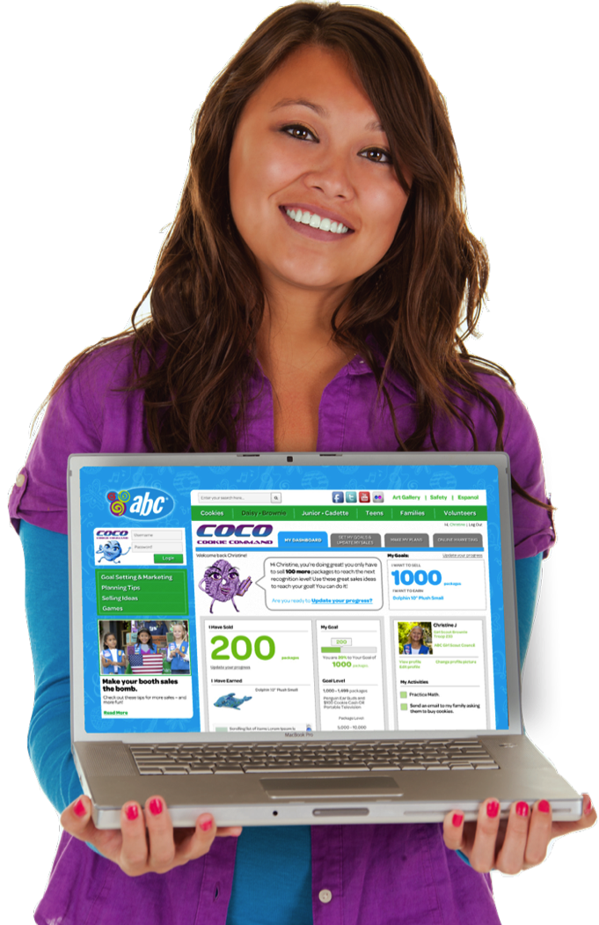
Community
Share achievements with troop
Cheer on troop teammates
Social media sharing for teens
Volunteers can share news and tips with girls and families

Slide 22
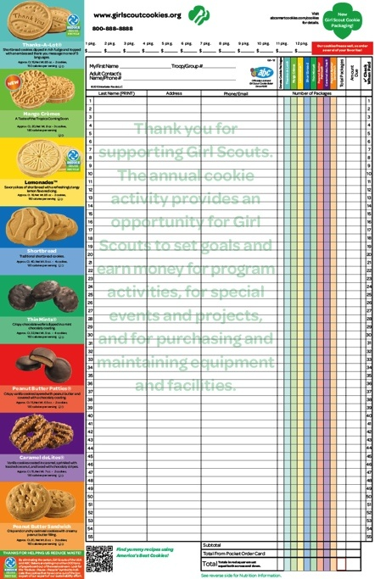
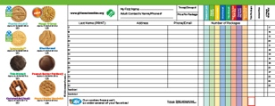
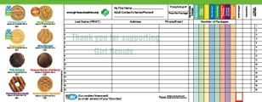
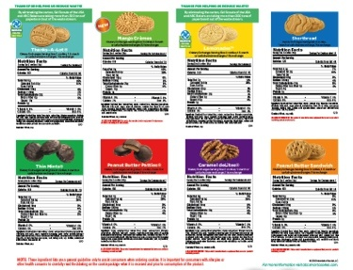
Multi-Purpose, Custom Order Card
Features our council’s recognition program
Includes information about COCO, the new online goal setting, planning and marketing app for girls

Slide 23
Resources
For Families

Slide 24
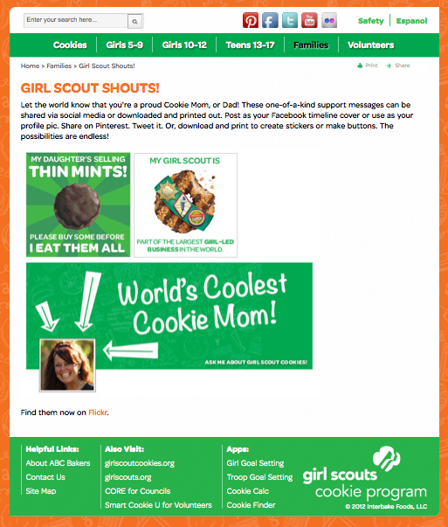
Online Family Engagement
Program Benefits/ 5 Key Skills
Ways to Support Your Girl Scout
Family Activities
“Ask Me About My Girl Scout”
Tools

Slide 25
Resources
For Volunteers

Slide 26
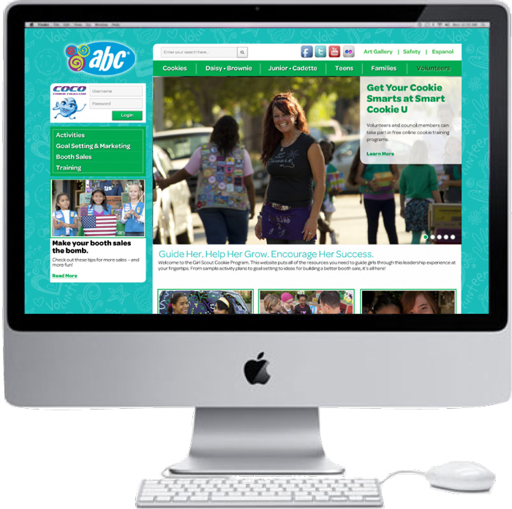
Digital Resources for Easy Access
Family Involvement Materials
Sample Session Plans by Grade Level
Troop Goal Setting App
Send girls online “cheers” and share information through COCO

Slide 27
Volunteer Toolkit
Guidance for training, goal setting, order-taking and booth sales
Activity ideas that link to 5 Key Skills

Slide 28
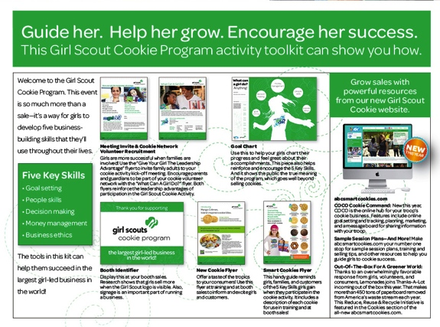
Volunteer Toolkit

Slide 29
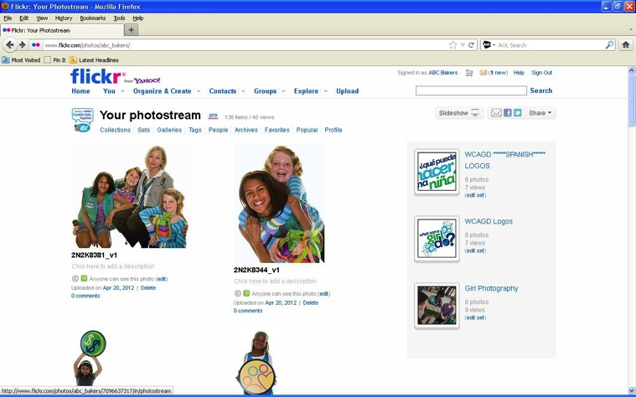
New Art Gallery
Download exciting images in high or low resolution from our new online art gallery

Slide 30
Boost your Sales!
Marketing tools to boost your sales!

Slide 31
All Troops will enter an Initial Order in Snap – FULL CASES
Cupboards may now transfer cookies in BOXES
Troop Reorders will be a TRANSFER from Cupboard to Troops

Slide 32
The Cookies Are Here!

Slide 33
Our Recognition Program
{Insert council-specific clip art images, information and/or final customized order card here}

Slide 34
Key Points for Family Training
Have
FUN!
How To Get Help
Online Resources
Skill Building
Goals
Cookies
Safety
Dates

Slide 35
Thanks from all of us!

