Slide 1

Girl Scouts of Southeastern New England

Slide 2

Notes:
Dream, Design, Do! is the theme for this year! And the adorable hedgehog is our mascot!

Slide 3

Notes:
Lets start with the Cookie Program highlights.

Slide 4


Who Can Sell Girl Scout Cookies?
All registered
Girl Scouts can sell cookies if they have parental permission.
Notes:
Who can sell Girl Scout Cookies? All registered Girl Scouts can sell if they have permission from a parent or guardian. From a Daisy in her first sale to a Ambassador in her last sale, all girls want to participate. Make it easy and fun for them.

Slide 5





The Five Essential Skills
Business Ethics
Goal Setting
People Skills
Money Management
Decision Making
Notes:
The Cookie Sale supports learning in a fun environment. Girls learn by doing. The Girl Leadership Experience invites girls to make decisions around the Cookie Sale! Troops and girls set goals – both sales and learning goals. They practice business ethics by following the sale guidelines and selling dates. Money management takes the lead when girls make change or budget their cookie money to support troop activities. And we all know that girls practice and develop people skills as they interact with each other and their customers!
Let’s Review the 5 Skills
Goal Setting: At the start of the sale, girls will set a goal. And it’s not just about how many boxes of cookies she sells. Her goals should also be based on things she’ll learn, experiences she’ll have, and what she’ll be able to accomplish once she reaches her sales target.
Business Ethics: Throughout the sale, she’ll be making decisions, both with the group and as an individual. What will they do with the funds they generate? Where would be the best place for a booth sale? You’re here to help her sharpen her skills for making good choices.
Money Management: For many girls, this is the first time they’re responsible for handling money. Through the sale, they’ll learn all about accountability and the importance of accuracy and safety.
People Skills: The Cookie Sale is a great way to encourage positive interaction with people. You’ll be amazed at how much confidence can be built along the way.
Decision Making: Girls will learn that strong values should lead any business — including theirs. Good thing they have you as a role model.

Slide 6
A Powerful Brand
$777MM
Notes:
The Girl Scout Cookie Sale is a powerful brand. Girl Scout cookie sales generated over 777 MILLION dollars in sales last year. 75% of that money stayed in Girl Scout Councils – at the troop and council level – to support Girl Leadership Experiences.
And the most popular Girl Scout Cookie varieties resonate with consumers! Of the top ten cookies sold in the country Girl Scouts has four of those cookies! And we only sell them for about 12 weeks out of the year – everyone else sells their cookies year round. Another testament to power of girls and the volunteers who support them.

Slide 7

When Does the Sale Start?
December 19, 2015
(All girls whether in Order Taking or Direct Sale Troops may begin taking orders on this date!)
Notes:
ACTION: Insert your council-specific dates and other key information

Slide 8
Important Dates
December 19, 2015 to January 14, 2016
January 16 – March 27
January – March
In SNAP+ by March 29
Due by April 22
May 2016
Girls Take Initial Orders
Girls Deliver Cookies
Cookie Booths
Recognitions Orders
Cookie Credit Transfers
Celebrate

Slide 9
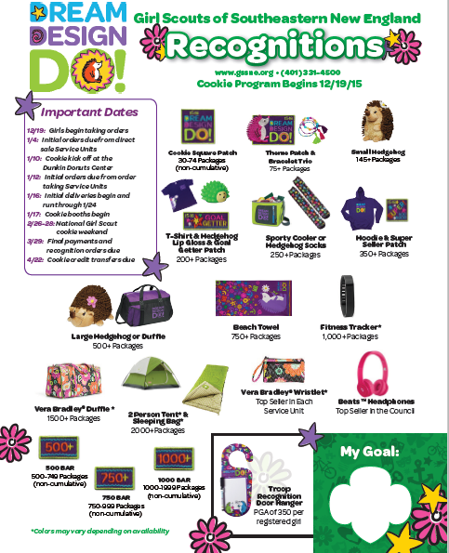
Our Recognition Program
Notes:
ACTION: Insert your council recognition plan

Slide 10


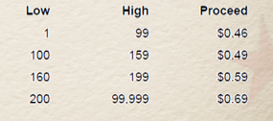
What Can We Earn?
Every Girl earns $0.20 per package that can be applied to GSSNE Summer Camps
Notes:
ACTION: Insert your council-specific information

Slide 11

Our Council’s Goal!
748,274 Packages

Slide 12
Notes:
Now on to marketing

Slide 13

How do we sell cookies?
Order Taking/Direct Sales
Booth Sales
Online Marketing
COCOmobile
COCOdirect
Notes:
Today’s girls are on the move, and we want to support their sales efforts in a variety of ways. How do girls sell today?
Order taking – in an order taking sale, the sale starts with girls and their order cards hitting the streets and collecting orders. But even in a direct sale, order taking has a role! If a girl is currently out of one variety, she can continue to sell and take orders to be filled at a later date for the other cookies. Or she may follow up 10–12 days after the start of the sale and take orders for additional cookies as her customers may have eaten their first purchase!
Online marketing – in addition to using the order card to collect orders, girls can expand their customer base by using the online marketing tools. Girls can send eCards to their regular customers to collect orders and spend more “boots on the pavement” time finding new customers. She can also use the online cards to contact folks in the case of inclement weather! The online marketing option also has a COCOdirect experience – more about that in a minute.
Direct sales – direct sales are different than booth sales. Direct sales really refer to a single transaction – the girl has cookies in hand, she sells to the customer, and collects money all in one step. Direct sales can be door to door like order taking, or it can be special event based sales like cookie caravans, where a troop goes to a new, untapped neighborhood, or cookies and milk breaks at a local business.
Booth sales – traditionally held outside grocery and other retail markets, this segment of the sale continues to be popular. We’ll get into more detail on our booth programs later in training, but we need to think outside the “cookie booth box.” What about a drive-through booth or setting up a booth at a food truck festival or other community event?
COCOmobile – this easy to use free app, available on both the iPhone and Android platforms, is a digital order card. Instead of a paper card, girls enter their order and customers get an email confirmation of their order! Girl delivery is still necessary through the traditional COCOmobile. Girls who took their orders last year on the mobile app sold an average of seven more boxes per girl – a great way to boost sales!
And introducing our newest sales method – COCOdirect. This is a direct-to-consumer order process where the girl either sends out an eCard through COCO online, or takes an order for COCOdirect through the mobile app. The customer orders, pays for, and receives the cookies with money collection or delivery by the girl. We have more details later in this presentation.

Slide 14

Cookie Sale Resources
Inspire and inform girls and their families
Make sale as easy as possible to support
Provide multiple formats for busy volunteers!
Notes:
Go the next slide to see all of the cookie materials that we will have available this year!

Slide 15
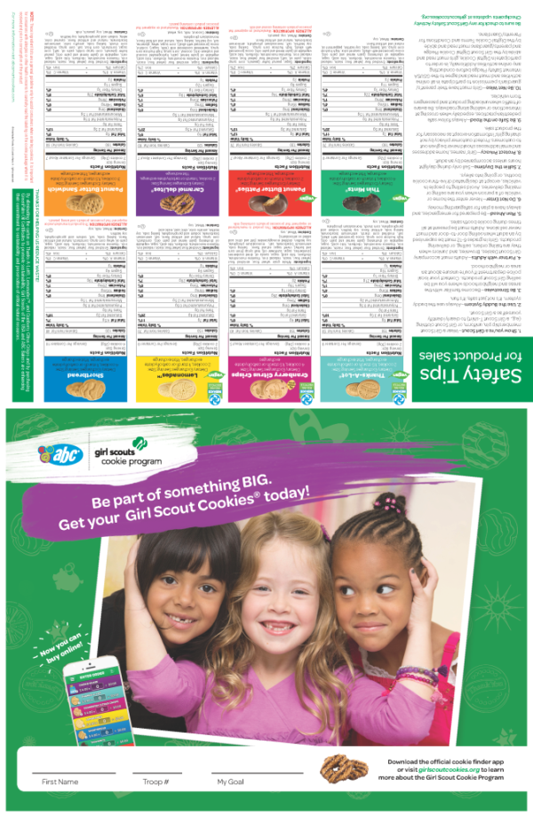
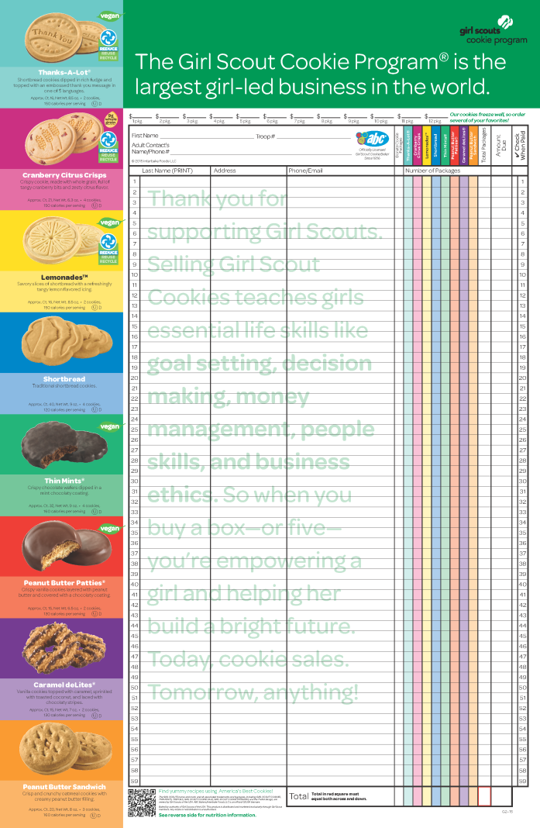
Cookie Order Card
Notes:
You have seen that we are really cutting down on paper but there are a couple of pieces that are important to print. First is the Order Card. We know this is the one piece that always gets home, so it has great information for our girls. With lots of space to take orders, nutritional information, and safety tips all in one place.
Multi-purpose, customized order card for our council
Features our council’s recognition program
Includes information about COCOmobile, the new mobile app for girls and COCO online upgrades too

Slide 16
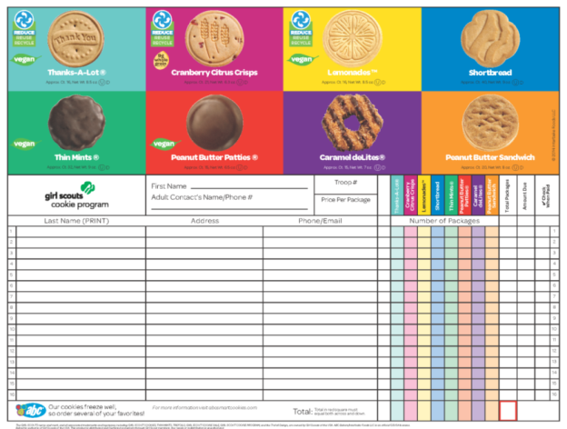
Mini Order Card – For on the go ordering!
  For the 15-16 Season, a mini order card will be available digitally for on-demand printing
  Ways to use it:
  Follow-up orders after Initial Orders are turned in
  A portable order card that older girls can store in their purse or
  backpack
  A card for parents to take to work with a note from their girl
  A piece to leave at locations to collect orders, i.e., school office

Slide 17
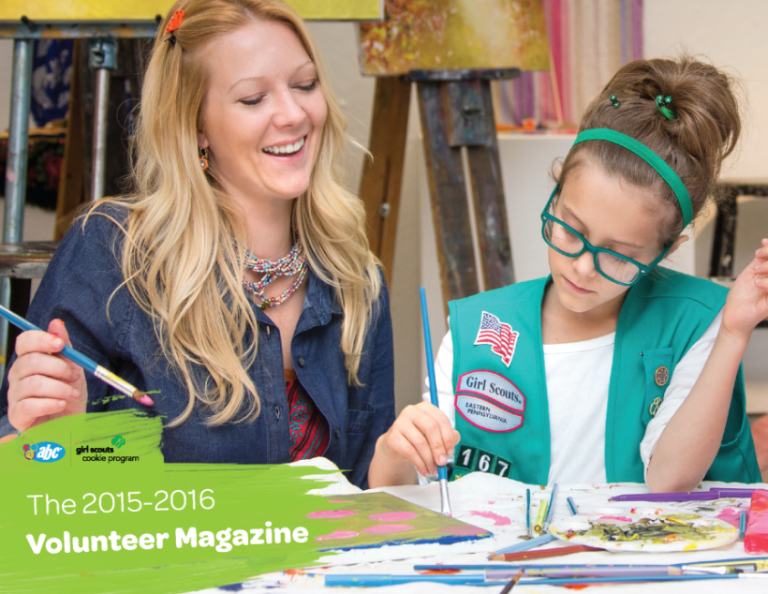
Volunteer Magazine
What’s New? – We have an updated look
This year, the Volunteer Magazine is a much more engaging and interactive piece. It will be a digital piece like last year and include:
Video tips and testimonials from volunteers/parents/Girl Scouts
ABC Technology Video showcasing our great online resources
Downloadable tips and activity how-to’s
Cookie Line Up
AND Materials Survey for volunteer feedback
Notes:
Don’t forget to visit abcsmartcookies.com to access the volunteer tool kit and encourage all troop volunteers, leaders, and cookie chairs to do the same. A one-stop shop for everything you need for a successful sale.

Slide 18

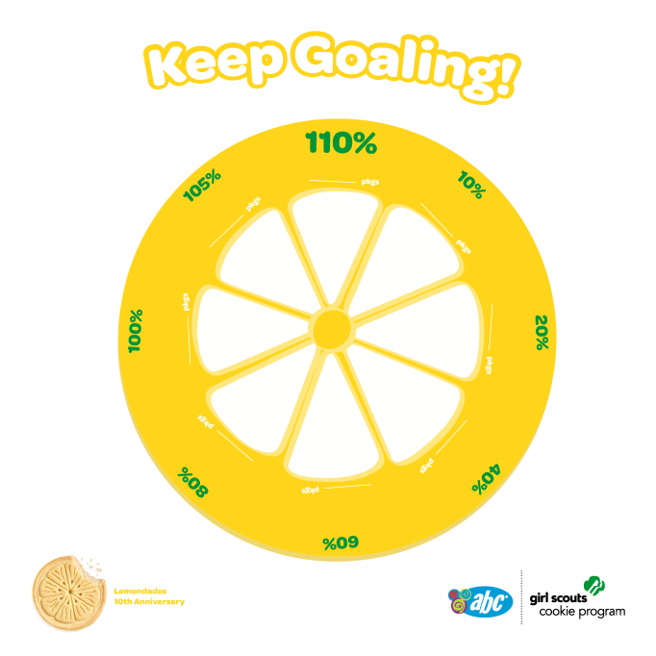
Booth Identifier
Notes:
Printed and available for every troop to promote their booth sales!

Slide 19
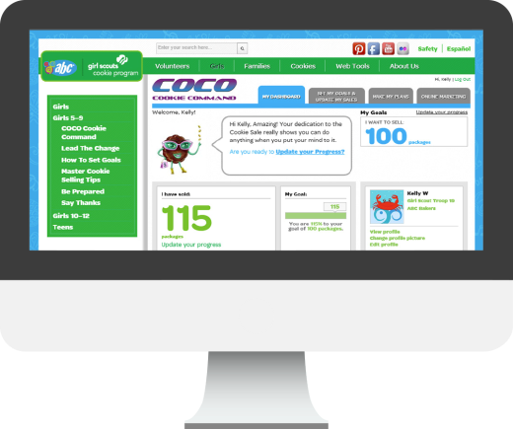
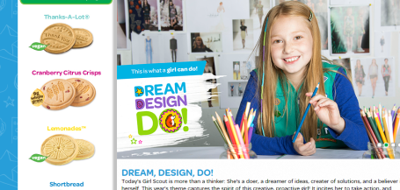
Resources on our Baker’s websites:
  Cookie Calculator
  Business planning tools on COCO Cookie Command and ABC Website
  Overview of activities and milestones related to the Girl Scout Cookie Sale
  Resources to leverage and train troops and volunteers
  Types of images on Smart Cookie U that help support cookie sale flyers, social media and other sales materials
  Mobile apps provided by ABC to help manage cookie sales inventory
Notes:
Cookie Calculator: The ABC Bakers Cookie Calculator helps volunteers set package sales goals based on number of packages sold last year and the desired percentage increase this year.
Once package sales goals are set, encourage girls to enter their goals into COCO to track progress over time.
Business planning tools on COCO Cookie Command and ABC website:
- The Troop Budgeting Worksheet
- Goal Setting
- Cookie Calculator
3. Overview of Activities and Milestones related to the Girl Scout Cookie Sale:
The Check List for Success is available through Smart Cookie U and includes a step-by-step list of all the activities needed for a successful season, from planning and preparation to making the sale happen and celebrating success.
4. Resources to Leverage and Train Troops and Volunteers:
We offer a variety of training resources to accommodate busy lifestyles and that can all be leveraged via email blast, webinar, or in-person training sessions. The key is to provide a steady stream of materials!
The Volunteer Magazine available through Smart Cookie U includes information on safety guidelines, teaching girls the 5 Essential Skills, an overview of our tech tools, this year’s cookie lineup, and building better booth sales.
Cookie Universities are workshops aimed at Cadette through Ambassador Girl Scouts to help them broaden their scope of cookie activities and achieve more. We provide workshop ideas at Smart Cookie U and encourage troops to recruit members of the community to teach these sessions on budgeting, logistics, customer mapping and more!
Smart Cookie U resources, like The Master Cookie Selling Tips, provide a wealth of ideas for troops to kick their sale into high gear
ABC Bakers YouTube videos are a great training resource. Examples include our ABC Web Tools Tips video, which gives an overview of Smart Cookie U, COCO, COCOmobile and COCOdirect, and the Safety Tips video
ABC Webinars, like the COCOdirect Webinar for Girls and Volunteers, are also accessible on our YouTube channel
The Rally Guide available at Smart Cookie U soon is a great resource for training girls and getting them excited as they ramp up for cookie season!
5. Types of Images on Smart Cookie U that help support cookie sale flyers, social media and other sales materials:
Smart Cookie U contains a link to the ABC Council Flickr page with a variety of images for all of your needs, including:
15-16 recognition items
15-16 volunteer items
15-16 It’s Cookie Time items
15-16 patches
15-16 clip art of mascots, words/phrases, icons, doo dads and patterns
14-16 photography
6. Mobile apps provided by ABC to help manage cookie sales and inventory:
Snap Cupboard allows registered cupboard managers to sort orders by troop, create and edit planned orders, confirm pick-up of planned orders, transfer inventory and view paperless receipts
COCOmobile is an app for girls that puts all the cookie-order tools from COCO Cookie Command at their fingertips.

Slide 20


Marketing Materials and Graphics Available
All theme clip art, photography, cookie images and social media graphics can be found on Smart Cookie U
Make sure you have a COCO account and you can log in to SCU today!
Notes:
www.abcsmartcookieu.com

Slide 21
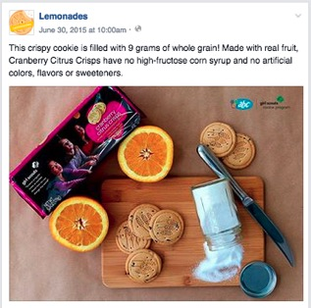
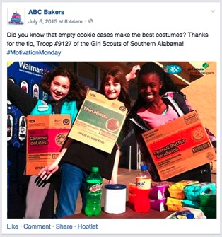
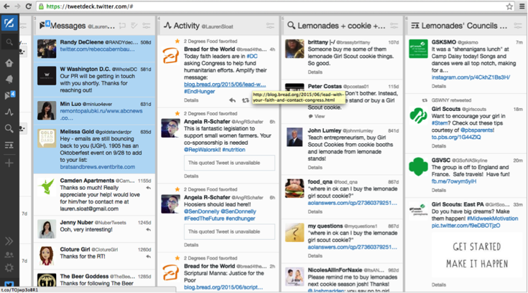

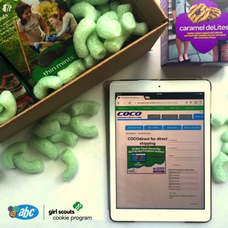
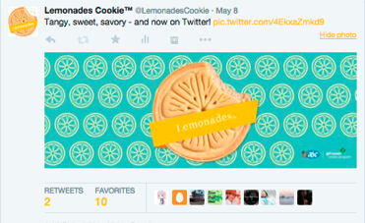


Social Media
Notes:
ABC Bakers Social Channels:
The ABC Bakers Facebook page is used to excite and energize volunteers and troops about cookie sales with sales strategies, success stories, technology tips and more.
Our Lemonades Facebook page and Twitter handle are designed to leverage consumer love for this star ABC Bakers product, generate more product buzz, and educate the general public about where to find the cookies they love.
2. Leveraging to find new sale’s tips, tricks, strategies and tools:
Like the ABC Bakers Page on Facebook! We link to product and sales resources from Smart Cookie U, highlight successful sales strategies from other troops and post handy tips and tricks all through the cookie season.
3. Social Media to Support Cookie Sales:
Volunteers and parents can support cookie sales through social media:
We offer pre-written tweets at Smart Cookie U that are designed for distribution to volunteers to build buzz and create demand with their friends and family. We encourage you to share them with volunteers and parents!
Volunteers and parents should also follow @LemonadesCookie on Twitter and like the @Lemonades Page on Facebook for fun cookie videos, photos and other content that can be shared and retweeted to their own followers.
You might also think about encouraging troops to hold a mini-rally party for volunteers, which could include some tips and tricks for using hashtags and mentions on social media to promote the cookie sale.
4. Sharing Sales Success Stories:
We are constantly looking for fun and engaging stories to share on behalf of our councils.
Here are a few ways to ensure that we see your stories to highlight on our channels:
Share them directly to the ABC Bakers Facebook Page
Mention the @Lemonades Facebook page or @ABC Bakers Facebook Page in your post [For example: “Hey @ABCBakers, our troop gave out samples of @Lemonades at our booth sale this weekend with great success. Check out our photo!”
5. Hashtags:
Whether you're on Facebook, Instagram, Pinterest, or Twitter, keep your social media accounts fresh — and insert your posts into relevant ongoing conversations — with these trending topics that pop up week after week, without fail:
#MondayMotivation: Sometimes, we’re all dragging on Mondays! This is a great hashtag to use if you want to share inspiring content from your troops such as great sales tips or other community initiatives.
#TroopTuesday: This is a great hashtag to use if you want to give a virtual high-five and highlight a particular troop. This could focus on a particular initiative they are involved in or achievement they have reached.
#ThrowbackThursday& #FlashbackFriday: These hashtags are great for inciting nostalgia and can allow you to share content surrounding past sales successes, growth, past events and even products.

Slide 22




Lemonades 10th Birthday!
Notes:
ABC Bakers’ fan favorite cookie, Lemonades™, is turning 10 years old — and we’re celebrating all year with a Lemonades-themed extravaganza!
These savory slices of shortbread with lemon-flavored icing are getting the star treatment, with a dedicated Facebook Page and Twitter channel to keep volunteers, girls and cookie lovers everywhere informed and excited about Lemonades.
Make sure to let your troops know to like Lemonades on Facebook and follow Lemonades on Twitter for fun videos, cookie recipes, troop activity ideas, and even a contest or two! Join us in celebrating this big year!
https://www.facebook.com/LemonadesCookie
https://twitter.com/LemonadesCookie

Slide 24
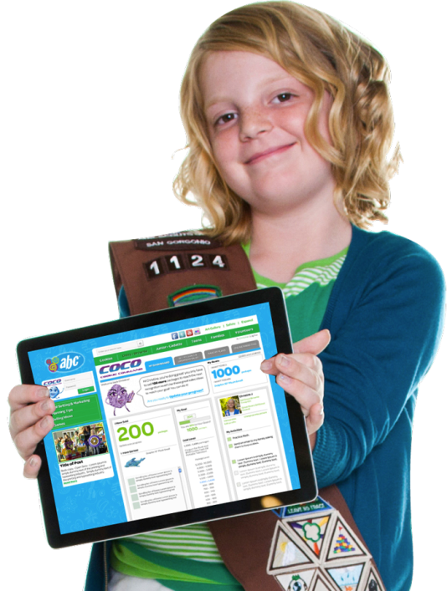


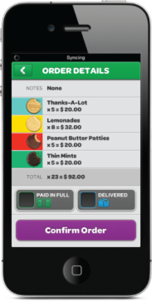

COCO Suite
Notes:
Key features of COCO Cookie Command:
Goal setting and tracking: Girls determine their individual cookie goals, record progress, and choose recognitions
Plan creation: Girls determine what activities they will undertake as part of their cookie program, choosing among a list of recommended activities and/or adding their own
Digital marketing tools: Girls can import contact lists, send ecards and place online orders
Custom girl dashboards: Girls can upload their own image or choose a fun avatar, see summaries of their activities, compare progress to others, and send and receive “cheers”
Custom troop dashboards: COCO’s troop page allows volunteers to post messages about the cookie sale to girls and monitor the troop’s progress
COCO Cookie Command and Smart Cookie U:
Smart Cookie U is an educational portal with resources about the ABC cookie program, marketing and sales tips, cookie information, and links to all of the tech tools we offer — including SNAP+ and COCO Cookie Command
COCO Cookie Command is ABC’s customized web-based “business center” for planning, managing and tracking girls’sales goals, online marketing efforts and successCOCOdirect Benefits:
Because using COCOdirect requires NO money collection and NO hand delivery, it’s a great tool for selling cookies to out-of-state relatives who want to support girls but do not live nearby for convenient money collection or cookie delivery!
Ways for Volunteers to Leverage COCOdirect:
Encourage volunteers to market this functionality on their own Facebook pages and through emails to friends and family! People interested in ordering cookies for direct shipment can simply respond with their information via email or send a private message on Facebook with their email address.
Girls can then send them a link to COCOdirect. Or, NEW this year, each girl will have a unique link to her COCOdirect site that she can share directly on Facebook or through email—making it easier to reach family and friends through social sites!

Slide 25
COCO Cookie Command
Goal Setting
  Set goals and track progress
Sales Planning
  Plan activities
Consumer Marketing
  Send ecards and generate reports

Slide 26

IMPROVED COCO ACCOUNTS FOR GIRLS
Girls set up new accounts for 2015-16
Accounts will be verified – girls in correct council/troop
Leaders can match girls if names aren’t exact match – Kathleen and Kathy for example
All girls receive the correct credit for digital cookie sales!

Slide 27
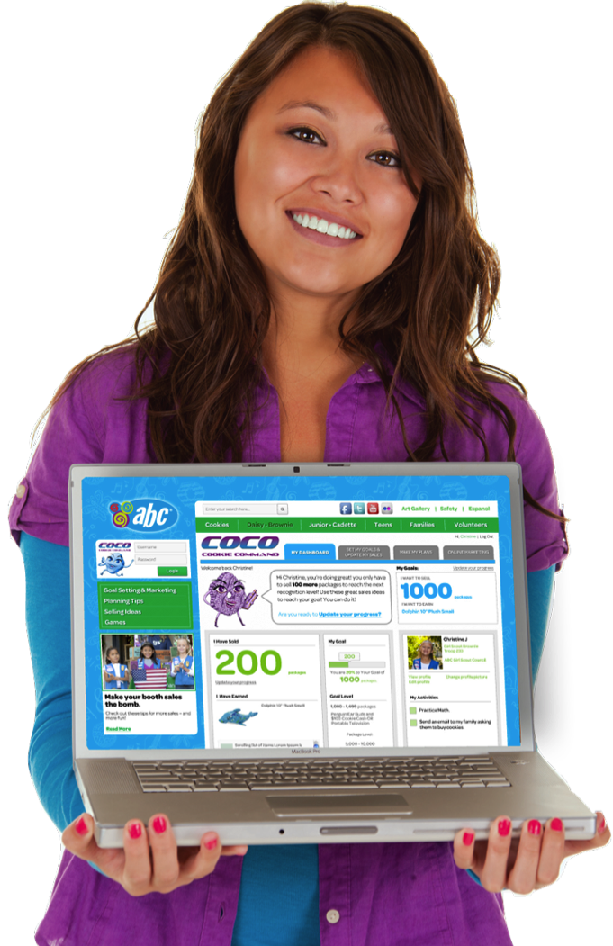
COCO for the Community
Volunteers should set up a COCO account
Links troop members
Share news with families
Sets up access to SCU for council specific information

Slide 28

Mobile Cookie App for Girls
  Set and track goals
  Take and manage cookie orders
    Track order payment and delivery status
    Email confirmations automatically sent to customers
    See a summary of orders and item totals
  View nutritional information with product images
  View recognitions, identify level achieved, track sales needed
  Automatically sync with online COCO information
  Access COCODirect with wireless or internet access
Notes:
We have the mobile app for girls – on both the apple and android platform this year. Easy handheld link to access all the information about a girl’s sales, from orders to progress towards goals.
Girls can take the digital order card with them anywhere and access anytime! An added bonus over the paper order card – email confirmations for consumers!

Slide 29
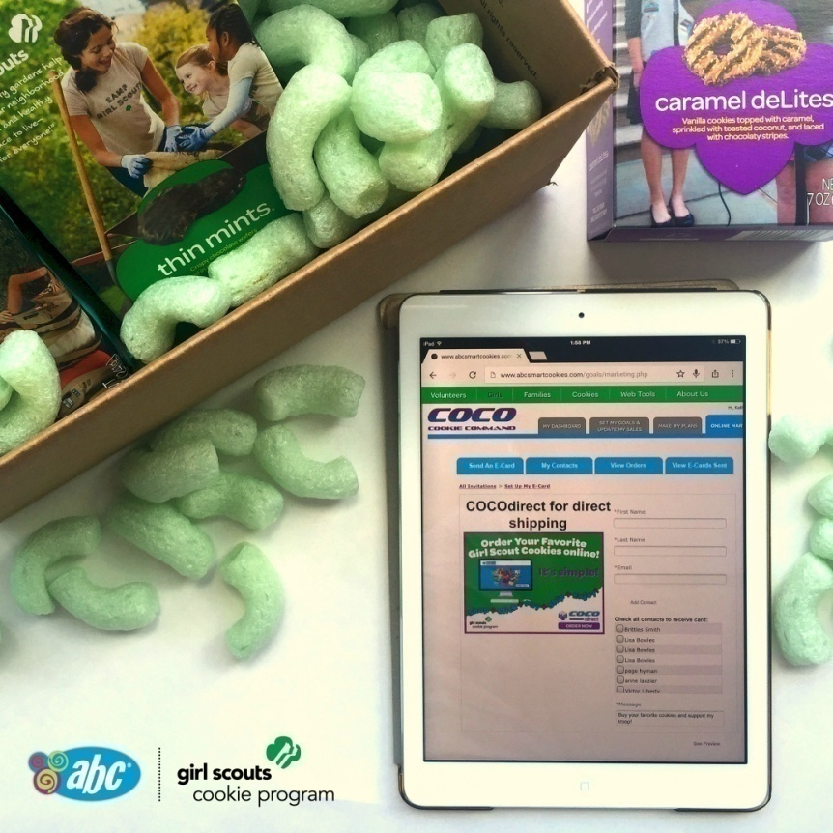
Direct Shipment of Girl Scout Cookies to Customers
COCOdirect is a mobile and online platform for online ordering and bulk direct delivery of Girl Scout Cookies
Note: Due to shipping costs, direct delivery through COCOdirect is ONLY available to consumers that purchase a minimum order of half dozen single variety or an eight-pack sampler.
Notes:
COCOdirect helps girls and volunteers streamline their cookie sale by allowing consumers to place large orders, pay with a credit card and receive direct shipment of cookies — a great option for anyone who wants to order Girl Scout Cookies in bulk or support a family member or friend who is a Girl Scout.
What is the difference between COCOmobile and COCOdirect?
COCOmobile and COCOdirect are both related to COCO Cookie Command — one is merely the mobile version, while the other is a distinct function available on both!
COCOdirect is the functionality that allows Girl Scout cookies to be shipped directly to consumers in bulk sizes, including:
An eight-pack sampler
A half dozen of any one variety
A dozen of any one variety
COCOmobile is the app that allows girls to access all the features of COCO cookie command on their mobile devices — including placing these direct-ship orders and inputting credit card and shipping information.

Slide 30
COCO SUITE ACTIVITY (ECARDS, MOBILE, DIRECT SHIP)
Notes:
ACTION: Enter in your council specific results! This is season preview of all ABC councils.

Slide 31
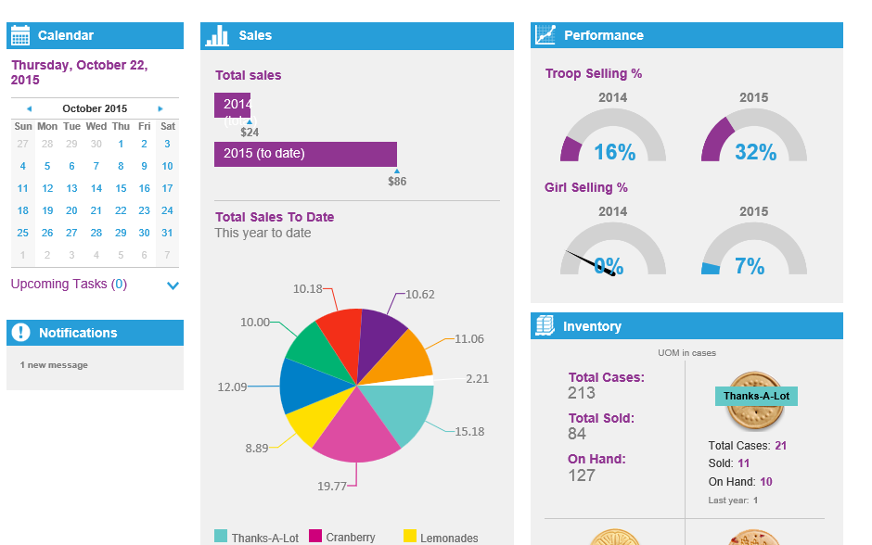
SNAP UPGRADE
+

Slide 32
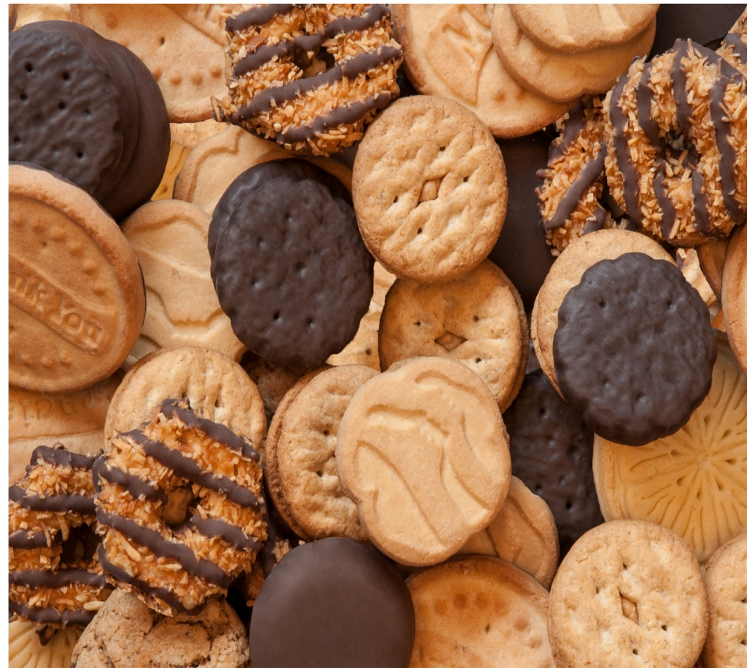

Cookies!

Slide 33
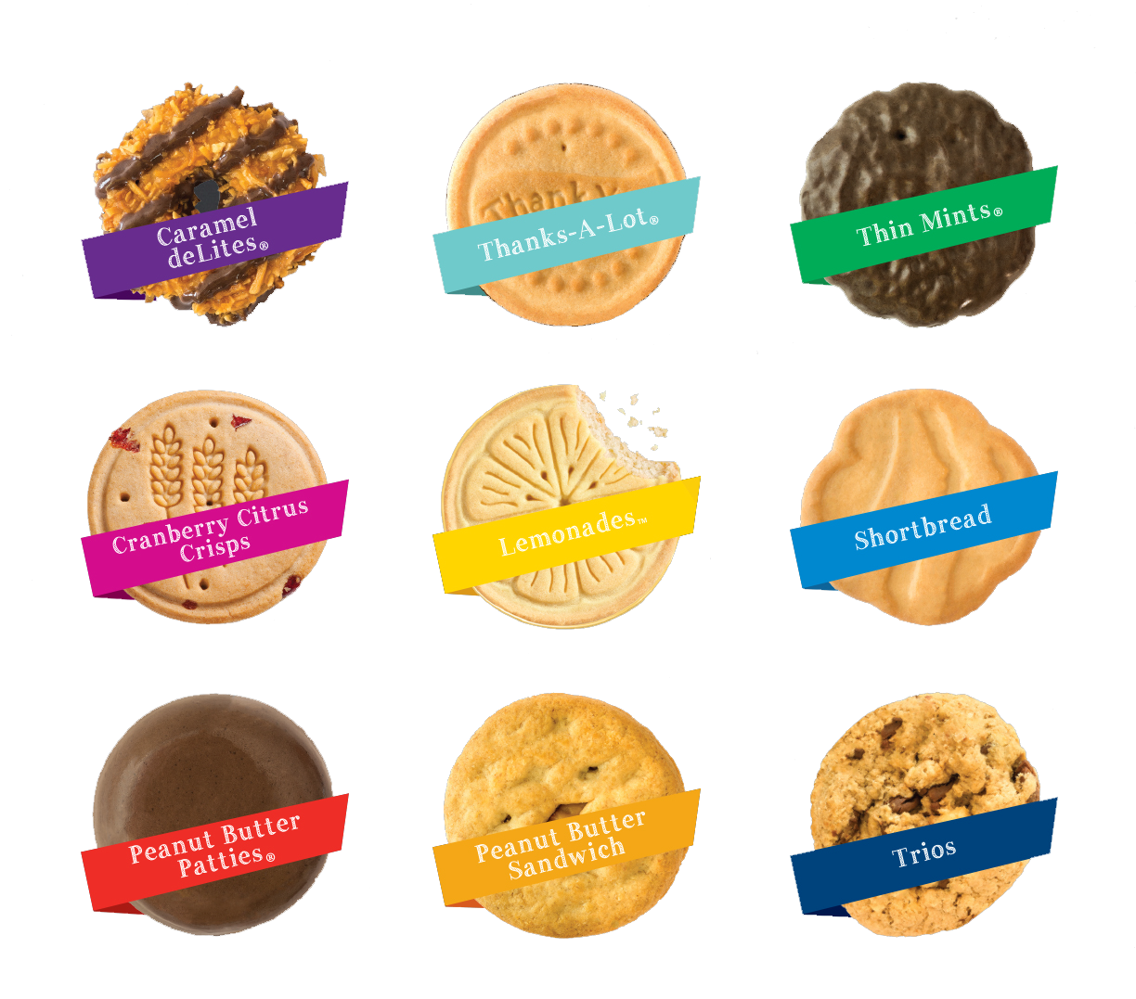
America’s Best Cookies!
Notes:
Our great 8 line up includes all the best cookies! From the ever popular Thin Mint to the best tasting breakfast snack cookie – Cranberry Citrus Crisps, everyone is sure to find a favorite.
ACTION: If your council is not participating in Gluten Free you may wish to delete the trios information

Slide 34
Average Sales Mix by Cookie
Notes:
This is a typical mix of the ABC cookie varieties. The demand may vary in your area and you can always pull information from Snap on what the mix was for an individual troop.
ACTION: Council may want to insert their past sales mix or if moving to a direct sale, present projected product mix for coming year

Slide 35








Training Highlights
Dates
Safety
Cookies
Goals
Skill Building
Online Resources
How to get help
HAVE FUN!
Notes:
It is always important to share consistent information with all of the groups involved in the cookie sale. If you are a SU Cookie Chair training troops, you want to have each of these components represented in your training. When troops train their girls and parents, they should share the same information. Consistent messages across the cookie sale will make for a successful year.

